Slide 1
INFO 341 Security Concepts and Issues
By
Bob Larson

Slide 2
Topics Covered
Security and Privacy Issues
Security Expectations
Security is Always a Trade-Off*
The Goals of Network Security
Network Security Weaknesses
Categories of Network Threats
Threat Types
Security isn’t Just a Network Issue
Many Security Tools
Security Life Cycle Wheels
General Data Protection Regulation

Slide 3
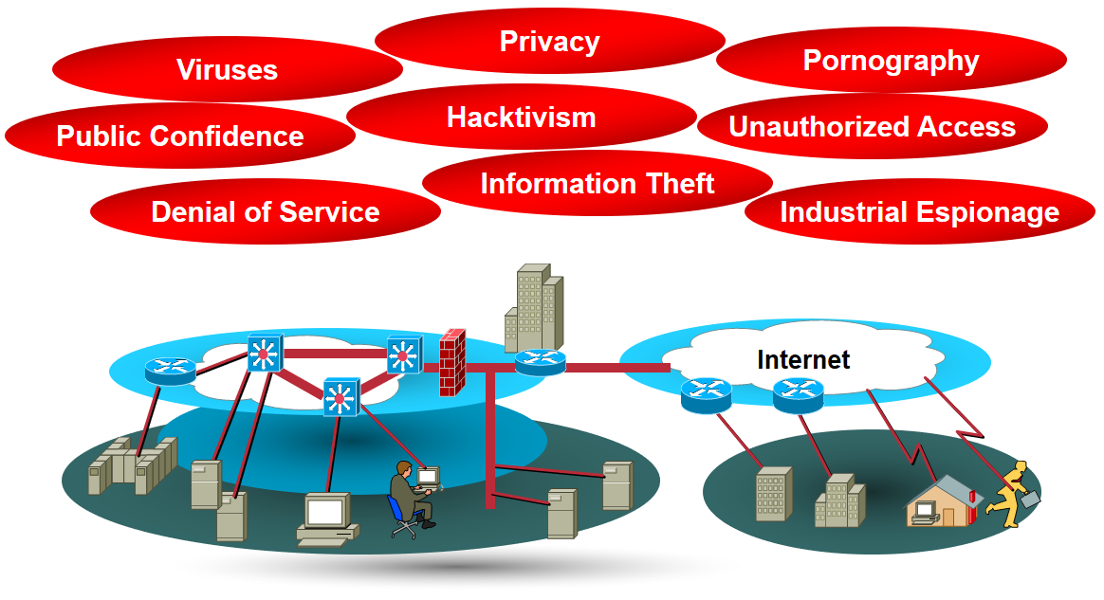
Security Concerns – List Grows Daily

Slide 4
Security and Privacy Issues
Network Security
Information
Hardware
Access
Facilities Security
Communications Security
Web Security
Transaction Security
Process Security
Technology Security (All)
National Security
Employee Security
Visitor Security
Personal Security
Proprietary Property Privacy
Company Data Privacy
Employee Privacy
Customer Privacy
Third-Party Privacy
Personal Privacy
Health Information Privacy
Regulatory Privacy or Reporting
Incident Reporting
Incident Notification
US Patriot Act
Local Laws and Requirements
Which Laws Apply
What about Theater?

Slide 5
Security Expectations
Users can perform only authorized tasks
Users can obtain only authorized information
Users can’t cause damage to the data, applications, or operating environment of a system

Slide 6
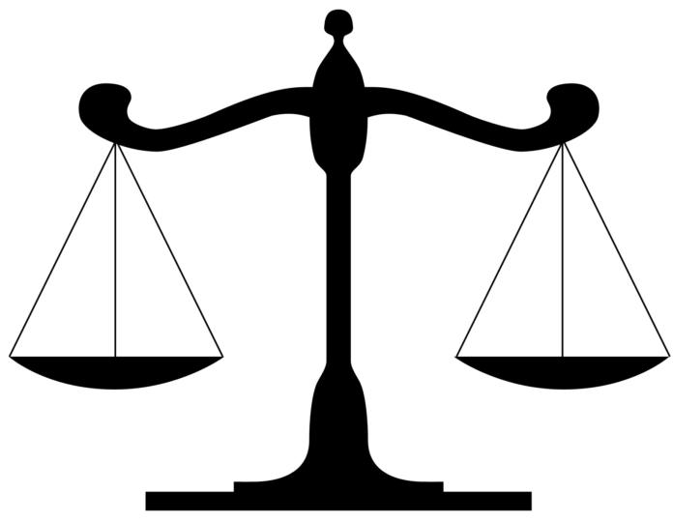
Security is Always a Trade-Off*
Security vs.
Cost
Complexity
Employee Hassle
Privacy
Functionality
Agility – moving quickly
Access
* But Don’t Be Stupid

Slide 7
The Goals of Network Security
Confidentiality
Integrity
Availability

Slide 8
Network Security Weaknesses
Technology weaknesses
Configuration weaknesses
Security policy weaknesses

Slide 9
Technology Weaknesses
All technologies have weaknesses or vulnerabilities
Known and unknown
What is unknown today can be discovered tomorrow
Don’t overlook:
Hardware issues – All devices connected to the network
OS issues
Network protocol issues (even TCP/IP)
Application vulnerabilities

Slide 10
Configuration Weaknesses
Insecure default settings
If you left the defaults, you are probably dead
Misconfigured network equipment
A little knowledge can be a dangerous thing
Insecure user accounts/passwords
End-users can’t be trusted to use strong passwords
Misconfigured Internet services
HTTP, Java, CGI, API, unneeded services

Slide 11
Security Policy Weaknesses
Lack of a written security policy
Internal politics
Lack of business continuity
Turnover in staff/management can be devastating
Logical access controls to network equipment are not applied
Security administration is lax, including monitoring and auditing
Lack of awareness of having been attacked
Software/hardware installation/upgrades don’t follow the policy
Security incident and disaster recovery procedures not in place

Slide 12
Categories of Network Threats
Unstructured
No specific target
Structured
Specific target (organization or person in organization)
Internal
Originated from within
External
Originated from the outside

Slide 13
Threat Types
Reconnaissance Attacks
Mapping, sniffing, port scanning – looking for an entry
Access Attacks
Attempting to enter
Denial of service (DoS)
In all its implementations

Slide 14
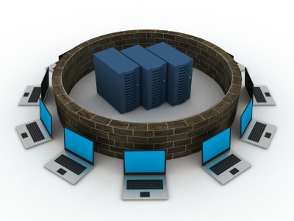
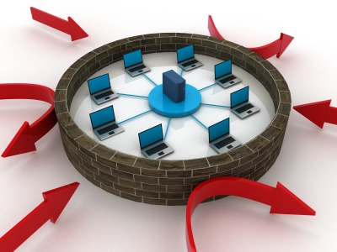
Constant Change Over Time
Technology
Attitudes
Threats and Enemies
Laws
Governance Role
Location
Global Scope
Employees

Slide 15
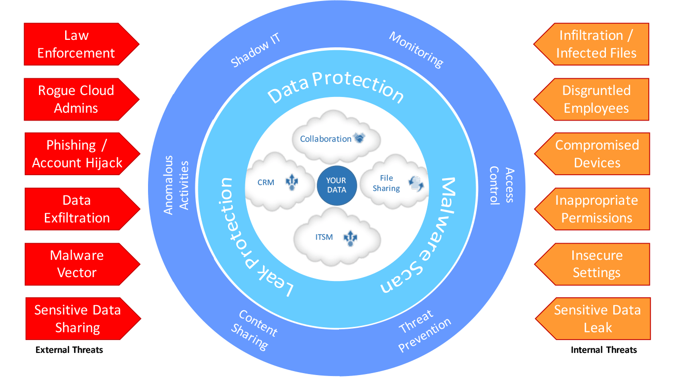
Threats in the Cloud

Slide 16
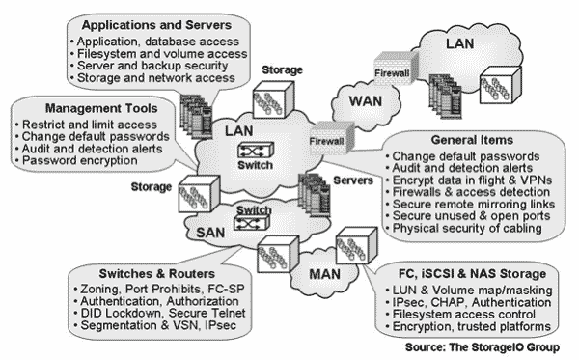
Security isn’t Just a Network Issue
Users, Servers, DBAs, Programmers, Management all play a role.

Slide 17
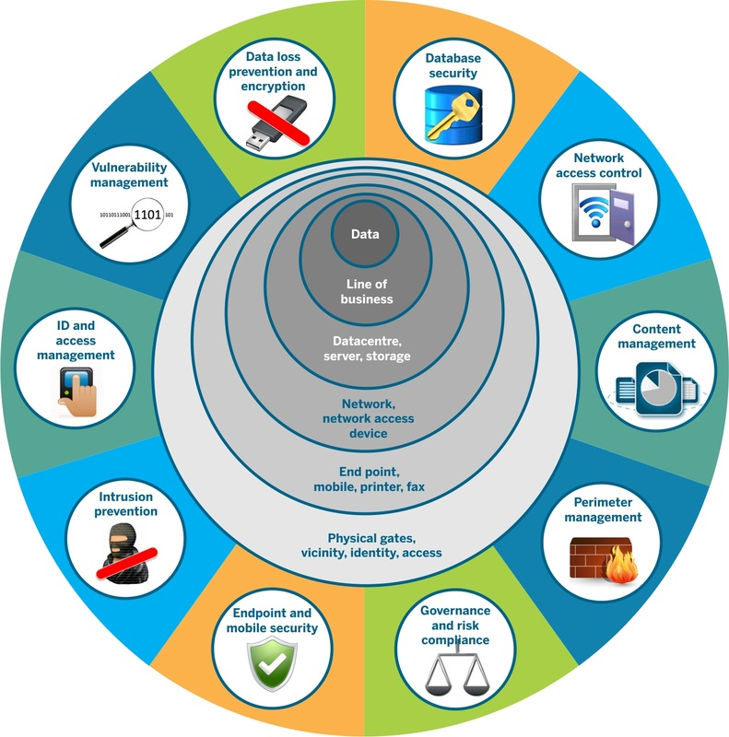
Many Security Tools

Slide 18
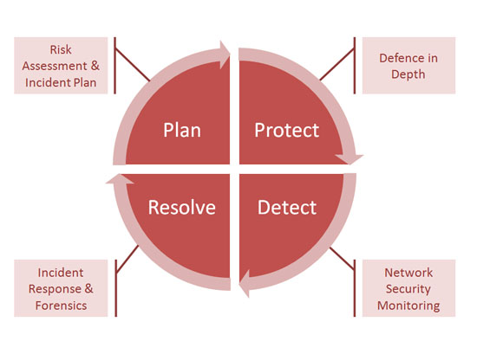
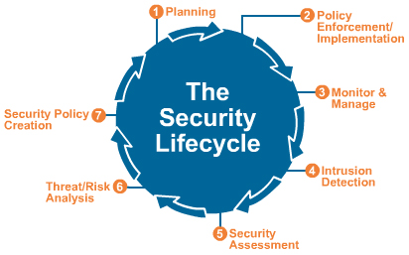
Security Life Cycle Wheels (Network)

Slide 19
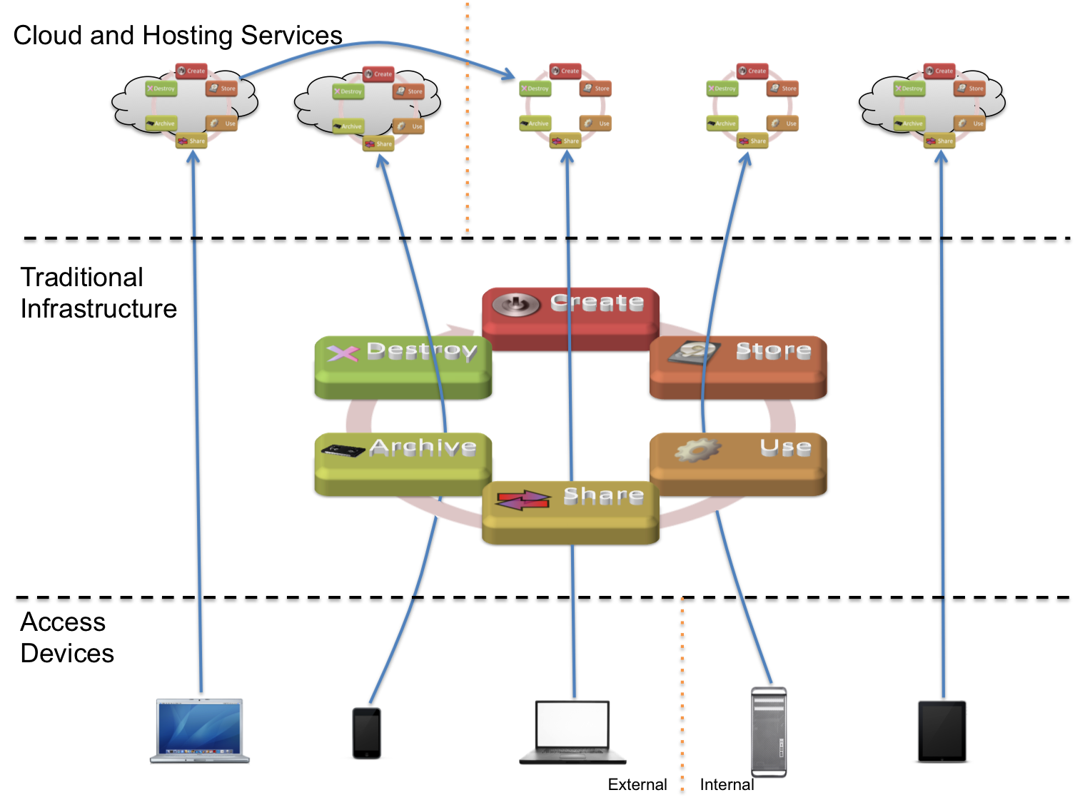
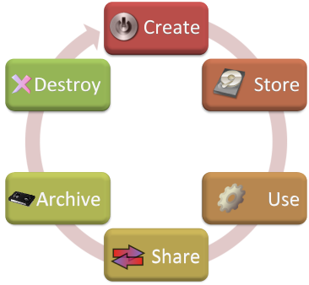
Data Security Life Cycle and the Cloud

Slide 20
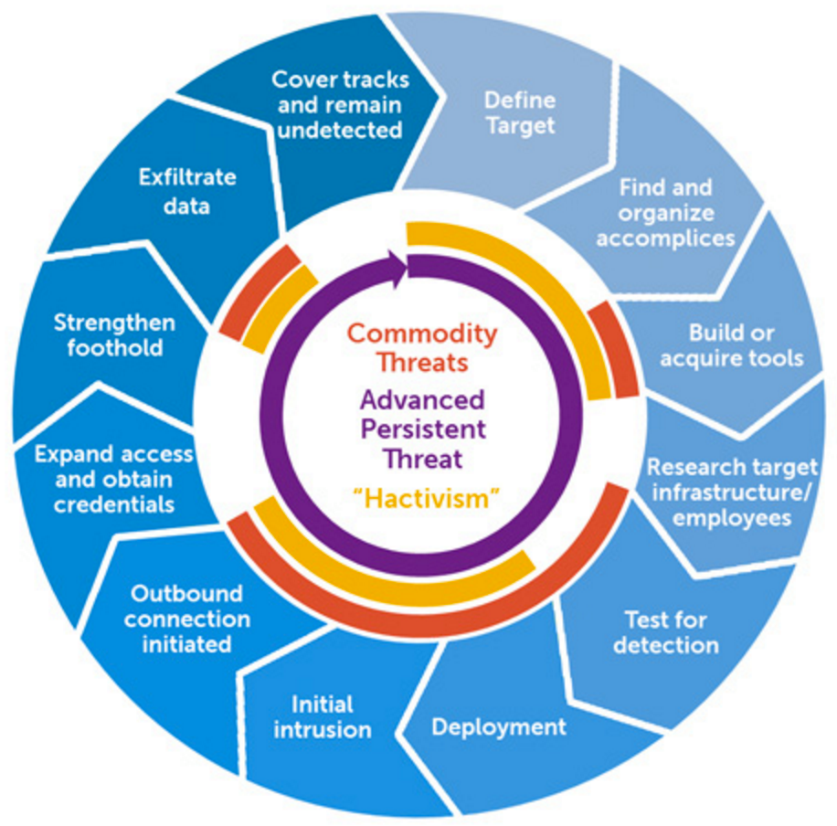
Attackers Have a Wheel Too

Slide 21
General Data Protection Regulation
EU Regulation 2016/679
Strengthen/unify data protection for all people within the EU
Also addresses the export of personal data outside the EU
Gives control to citizens and residents over their personal data
Goes into effect 25 May 25, 2018
Doesn’t require national governments to pass any legislation
It is thus directly binding and applicable
A single set of rules applies to all EU member states
Fines are huge (up to 10 or 20 million Euros or 2% or 4% of preceding years profits worldwide)

Slide 22
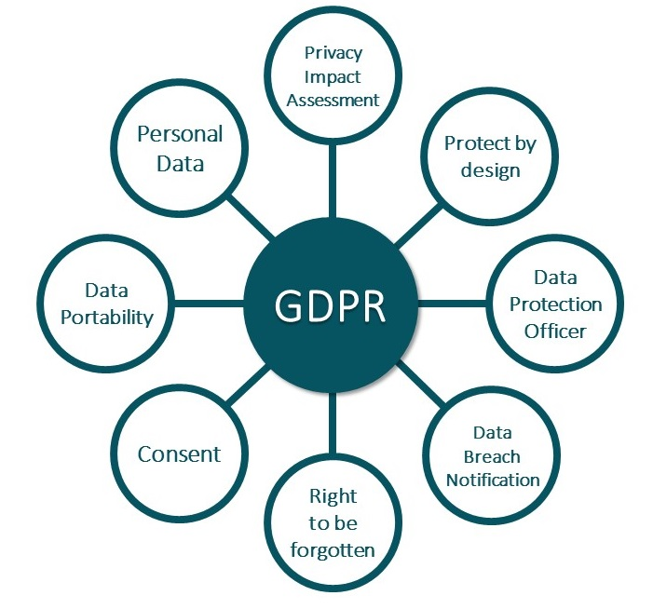
GDPR Key Points
All systems, software, storage, contractors
It is your data
As easy to Deny as Accept
72 hours
Data must be removed when no longer needed

Slide 23
Fin…

